Slide 1
Assessment of the Students’ Competences in Higher Education and their Development Dynamics during the Study Period
Zanda Rubene, Ģirts Dimdiņš, Anika Miltuze
University of Latvia
„Augstākajā izglītībā studējošo kompetenču novērtējums un to attīstības dinamika studiju periodā” ESF projekta Nr. 8.3.6.2. “Izglītības kvalitātes monitoringa sistēmas izveide un īstenošana” ietvaros
Projekta līguma numurs: 8.3.6.2/17/I/001 (23-12.3e/19/103)

Slide 2
Topicality of the project
A New Skills Agenda for Europe ( European Commission, 2016) shows that one of the most topical problems in modern higher education is the gap between the competences of university graduates and the knowledge and skills required for the economy. Therefore, universities need a better understanding of the achievements of university graduates.
The European Commission supports and promotes the development of student competence assessment frameworks for different areas of higher education in order to ensure a comparable assessment of students’ and graduates' skills.
Transversal competences have been cited as equally important as professional competences, as evidenced by the crisis caused by Covid 19.

Slide 3
Topicality of the project
In order to solve the above mentioned problem, at the end of 2019 the Ministry of Education and Science and the University of Latvia signed a cooperation agreement on the implementation of the project «Assessment of Students' Competences in Higher Education and their Development Dynamics during the Study Period».
The aim of the research is to study students' transversal competences - research, innovation, entrepreneurship, digital and global, as well as civic competence - to find out the dynamics of their development in the following fields of study: RIS 3, creative industries, public administration and education.
Development of a tool for assessing teachers' professional competences as an example of a test measuring professional competences. The first phase of the project will end in August 2021.

Slide 4
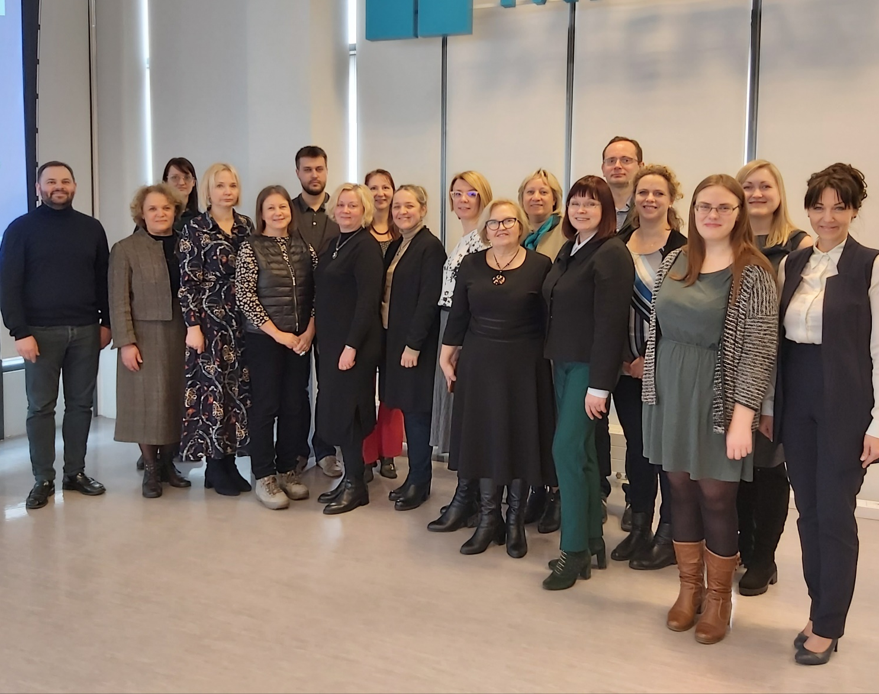
27 leading researchers, researchers, experts and research assistants from 8 universities and 1 company: LU, LiepU, RTA, RTU, RSU, DU, JVLMA, University of Groningen (Netherlands), educational company «Lielvārds».

Slide 5
First results
Transversal competences have been conceptualized and defined, their structures have been developed.
Within the framework of the project, a master's thesis has been defended, several scientific articles have been prepared and published, and two international seminars have taken place with the participation of Finnish and Dutch professors.
A tool for assessment of students' transversal competences has been developed, its approbation process is underway, at least 500 students with different study experience will participate in it (257 at the moment).
A tool for assessing the professional competences of teacher education students has been developed, the approbation of which will start already in February 2021.

Slide 6
Challenges
The developed transversal competence questionnaire is very voluminous – it takes about two hours to complete. How to motivate students to get involved?
To supplement the indicators for the assessment of the dynamics of the development of students' competences in the quality monitoring system of the higher education; set of indicators of learning outcomes (impact on human resources).
Professional responsibility and autonomy as an indicator to bridge the gap between academic knowledge and labor market requirements.

Slide 7
Professional Autonomy
The term, “Professional Autonomy”, has been ubiquitous since the World Medical Association Declaration of Madrid on Professional Autonomy and Self-Regulation (1987).
“Professional Autonomy” means the quality or state of being independent and self-directed, especially in making decisions, enabling professionals to exercise judgment as they see fit during the performance of their jobs.
How can this be evaluated empirically?
We return to the systemic analysis of literature - to understand experience of measuring the professional autonomy in research.

Slide 8
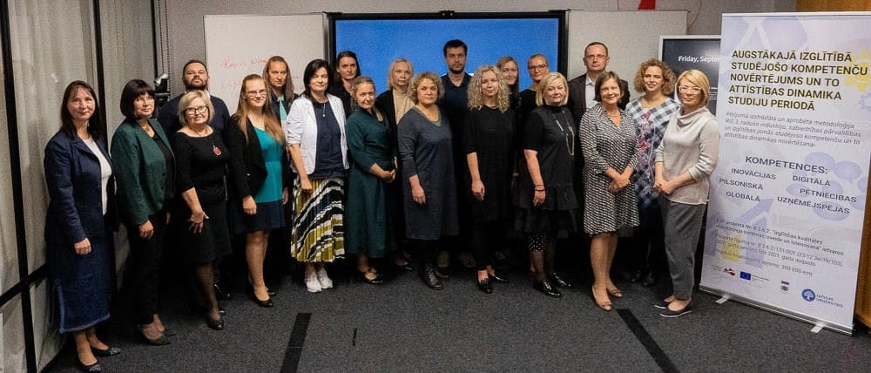
Thank you for your attention!

